Slide 1
Shared-memory Architectures
Adapted from a lecture by Ian Watson, University of Machester

Slide 2
Overview
We have talked about shared-memory programming with threads, locks, and condition variables in the context of a single processor.
Now let us look at how such programs can be run on a multiprocessor.
Two architectures:
  Bus-based shared-memory machines (small-scale)
  Directory-based shared-memory machines (large-scale)

Slide 3
Bus-based Shared Memory Organization
Basic picture is simple :-
Shared
Memory
CPU
CPU
CPU
Cache
Cache
Cache
Shared Bus

Slide 4
Organization
Bus is usually simple physical connection (wires)
Bus bandwidth limits no. of CPUs
Could be multiple memory elements
For now, assume that each CPU has only a single level of cache

Slide 5
Problem of Memory Coherence
Assume just single level caches and main memory
Processor writes to location in its cache
Other caches may hold shared copies - these will be out of date
Updating main memory alone is not enough

Slide 6
Example
Shared
Memory
1
2
3
X: 24
CPU
CPU
CPU
Cache
Cache
Cache
Shared Bus
Processor 1 reads X: obtains 24 from memory and caches it
Processor 2 reads X: obtains 24 from memory and caches it
Processor 1 writes 32 to X: its locally cached copy is updated
Processor 3 reads X: what value should it get?
Memory and processor 2 think it is 24
Processor 1 thinks it is 32
Notice that having write-through caches is not good enough

Slide 7
Bus Snooping
Scheme where every CPU knows who has a copy of its cached data is far too complex.
So each CPU (cache system) ‘snoops’ (i.e. watches continually) for write activity concerned with data addresses which it has cached.
This assumes a bus structure which is ‘global’, i.e all communication can be seen by all.
More scalable solution: ‘directory based’ coherence schemes

Slide 8
Snooping Protocols
Write Invalidate
  CPU wanting to write to an address, grabs a bus cycle and sends a ‘write invalidate’ message
  All snooping caches invalidate their copy of appropriate cache line
  CPU writes to its cached copy (assume for now that it also writes through to memory)
  Any shared read in other CPUs will now miss in cache and re-fetch new data.

Slide 9
Snooping Protocols
Write Update
  CPU wanting to write grabs bus cycle and broadcasts new data as it updates its own copy
  All snooping caches update their copy
Note that in both schemes, problem of simultaneous writes is taken care of by bus arbitration - only one CPU can use the bus at any one time.

Slide 10
Update or Invalidate?
Update looks the simplest, most obvious and fastest, but:-
  Multiple writes to same word (no intervening read) need only one invalidate message but would require an update for each
  Writes to same block in (usual) multi-word cache block require only one invalidate but would require multiple updates.

Slide 11
Update or Invalidate?
Due to both spatial and temporal locality, previous cases occur often.
Bus bandwidth is a precious commodity in shared memory multi-processors
Experience has shown that invalidate protocols use significantly less bandwidth.
Will consider implementation details only of invalidate.

Slide 12
Implementation Issues
In both schemes, knowing if a cached value is not shared (copy in another cache) can avoid sending any messages.
Invalidate description assumed that a cache value update was written through to memory. If we used a ‘copy back’ scheme other processors could re-fetch old value on a cache miss.
We need a protocol to handle all this.

Slide 13
MESI Protocol (1)
A practical multiprocessor invalidate protocol which attempts to minimize bus usage.
Allows usage of a ‘write back’ scheme - i.e. main memory not updated until ‘dirty’ cache line is displaced
Extension of usual cache tags, i.e. invalid tag and ‘dirty’ tag in normal write back cache.

Slide 14
MESI Protocol (2)
Any cache line can be in one of 4 states (2 bits)
Modified - cache line has been modified, is different from main memory - is the only cached copy. (multiprocessor ‘dirty’)
Exclusive - cache line is the same as main memory and is the only cached copy
Shared - Same as main memory but copies may exist in other caches.
Invalid - Line data is not valid (as in simple cache)

Slide 15
MESI Protocol (3)
Cache line changes state as a function of memory access events.
Event may be either
  Due to local processor activity (i.e. cache access)
  Due to bus activity - as a result of snooping
Cache line has its own state affected only if address matches

Slide 16
MESI Protocol (4)
Operation can be described informally by looking at action in local processor
  Read Hit
  Read Miss
  Write Hit
  Write Miss
More formally by state transition diagram

Slide 17
MESI Local Read Hit
Line must be in one of MES
This must be correct local value (if M it must have been modified locally)
Simply return value
No state change

Slide 18
MESI Local Read Miss (1)
No other copy in caches
  Processor makes bus request to memory
  Value read to local cache, marked E
One cache has E copy
  Processor makes bus request to memory
  Snooping cache puts copy value on the bus
  Memory access is abandoned
  Local processor caches value
  Both lines set to S

Slide 19
MESI Local Read Miss (2)
Several caches have S copy
  Processor makes bus request to memory
  One cache puts copy value on the bus (arbitrated)
  Memory access is abandoned
  Local processor caches value
  Local copy set to S
  Other copies remain S

Slide 20
MESI Local Read Miss (3)
One cache has M copy
  Processor makes bus request to memory
  Snooping cache puts copy value on the bus
  Memory access is abandoned
  Local processor caches value
  Local copy tagged S
  Source (M) value copied back to memory
  Source value M -> S

Slide 21
MESI Local Write Hit (1)
Line must be one of MES
M
  line is exclusive and already ‘dirty’
  Update local cache value
  no state change
E
  Update local cache value
  State E -> M

Slide 22
MESI Local Write Hit (2)
S
  Processor broadcasts an invalidate on bus
  Snooping processors with S copy change S->I
  Local cache value is updated
  Local state change S->M

Slide 23
MESI Local Write Miss (1)
Detailed action depends on copies in other processors
No other copies
  Value read from memory to local cache (?)
  Value updated
  Local copy state set to M

Slide 24
MESI Local Write Miss (2)
Other copies, either one in state E or more in state S
  Value read from memory to local cache - bus transaction marked RWITM (read with intent to modify)
  Snooping processors see this and set their copy state to I
  Local copy updated & state set to M

Slide 25
MESI Local Write Miss (3)
Another copy in state M
Processor issues bus transaction marked RWITM
Snooping processor sees this
  Blocks RWITM request
  Takes control of bus
  Writes back its copy to memory
  Sets its copy state to I

Slide 26
MESI Local Write Miss (4)
Another copy in state M (continued)
Original local processor re-issues RWITM request
Is now simple no-copy case
  Value read from memory to local cache
  Local copy value updated
  Local copy state set to M

Slide 27
Putting it all together
All of this information can be described compactly using a state transition diagram
Diagram shows what happens to a cache line in a processor as a result of
  memory accesses made by that processor (read hit/miss, write hit/miss)
  memory accesses made by other processors that result in bus transactions observed by this snoopy cache (Mem read, RWITM,Invalidate)

Slide 28
MESI – locally initiated accesses
Read
Miss(sh)
Invalid
Shared
Read
Hit
Mem Read
Read
Miss(ex)
Invalidate
RWITM
Mem Read
Write
Hit
Write
Miss
Modified
Exclusive
Read
Hit
Read
Hit
Write
Hit
Write
Hit
= bus transaction

Slide 29
MESI – remotely initiated accesses
Mem Read
Invalid
Invalidate
Shared
Mem Read
RWITM
Mem Read
RWITM
Modified
Exclusive
= copy back

Slide 30
MESI notes
There are minor variations (particularly to do with write miss)
Normal ‘write back’ when cache line is evicted is done if line state is M
Multi-level caches
  If caches are inclusive, only the lowest level cache needs to snoop on the bus

Slide 31
Directory Schemes
Snoopy schemes do not scale because they rely on broadcast
Directory-based schemes allow scaling.
  avoid broadcasts by keeping track of all PEs caching a memory block, and then using point-to-point messages to maintain coherence
  they allow the flexibility to use any scalable point-to-point network

Slide 32
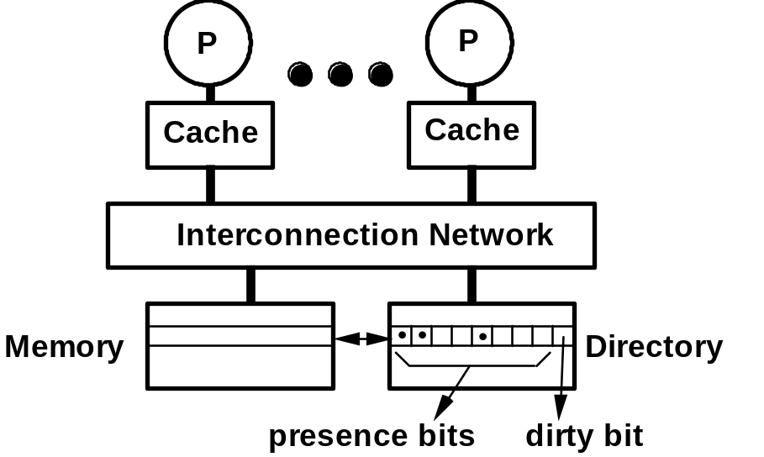
Basic Scheme (Censier & Feautrier)
• Assume "k" processors.
• With each cache-block in memory: k presence-bits, and 1 dirty-bit
• With each cache-block in cache: 1valid bit, and 1 dirty (owner) bit
  Read from main memory by PE-i:
    If dirty-bit is OFF then { read from main memory; turn p[i] ON; }
    if dirty-bit is ON then { recall line from dirty PE (cache state to shared); update memory; turn dirty-bit OFF; turn p[i] ON; supply recalled data to PE-i; }
  Write to main memory:
    If dirty-bit OFF then { send invalidations to all PEs caching that block; turn dirty-bit ON; turn P[i] ON; ... }
    ...

Slide 33
Key Issues
Scaling of memory and directory bandwidth
  Can not have main memory or directory memory centralized
  Need a distributed memory and directory structure
Directory memory requirements do not scale well
  Number of presence bits grows with number of PEs
  Many ways to get around this problem
    limited pointer schemes of many flavors
Industry standard
  SCI: Scalable Coherent Interface

